Slide 1

STATISTICAL ANALYSIS AND PROBABILITY
SHIVANGI GUPTA
P.G DIPLOMA DATA SCIENCE
ASSISTANT PROFESSOR
AASHIMA BANGIA

Slide 2

Introduction
Fundamental of Statistics
Types of Data
Categorical Variable
Types of Statistics
Descriptive and inferential
Normal Probability distribution
Skewness
Kurtosis
Hands on practice in Excel
Probability
Inferential statistics
Hypothesis testing
Covariance
Correlation
Regression
Seaborn library
Excel Performance Dashboard
CONTENTS

Slide 3
INTRODUCTION
Statistics simply means numerical data generally deals with collection of data, tabulation, and interpretation of numerical data.
It is a form of mathematical analysis that uses different quantitative models to produce a set of experimental data or studies of real life.
It is concern with data collection analysis, interpretation, and presentation.
It deals with how data can be used to solve complex problems.
It makes work easy, simple, provides a clear and clean picture of work you do on a regular basis.

Slide 4
FUNDAMENTALS OF STATISTICS
Fundamentals of statistics covers introduction to statistics, science of statistics. It deals with the relationship of mean, covariance and variance as well as weighted averages, death rates and time series.

Slide 5
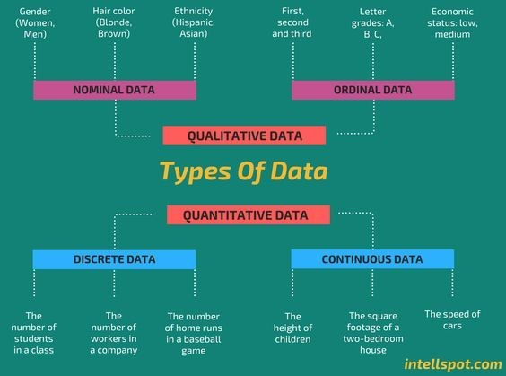
TYPES OF DATA

Slide 6
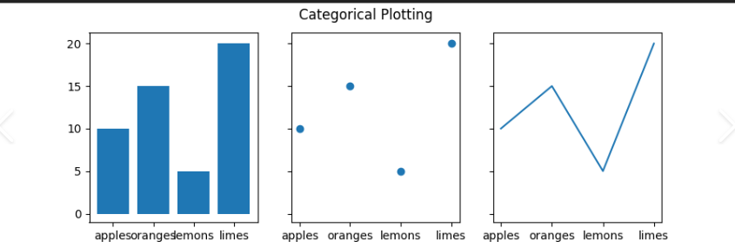
CATEGORICAL VARIABLE
A categorical variable (qualitative variable) take on one of a limited, and usually fixed, number of possible values, assigning each individual or other unit of observation to a particular group or nominal category on the basis of some qualitative property.
Categorical scatter plot

Slide 7
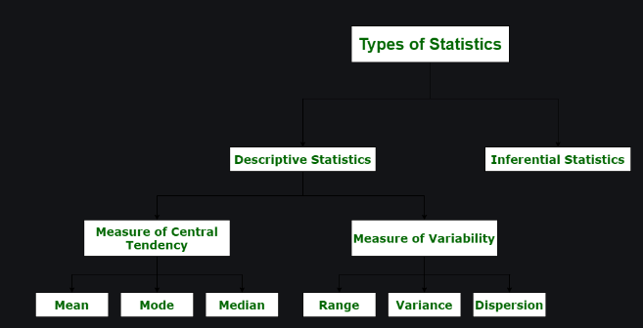

Slide 8
DESCRIPTIVE STATISTICS
Descriptive statistics are a part of statistics used to describe data.
It is used to summarize the attributes of a sample in such a way that a pattern can be drawn from the group.
It enables researchers to present data in a more meaningful way such that easy interpretations can be made.
These are given as follows:
MEASURES OF CENTRAL TENDENCY .
MEASURES OF DISPERSION.
MEASURES OF FREQUENCY.
MEASURES OF POSITION.

Slide 9
MEASURES OF CENTRAL TENDENCY
These help to describe the central position of the data by using measures such as mean, median, and mode.
MEAN = Σx_{i} / n
MODE = Most frequently occurring observation
MEDIAN (N IS ODD) = [(n + 1) / 2]^{th} term
MEDIAN (N IS EVEN) = [(n / 2)^{th} term + ((n / 2) + 1)^{th} term] / 2

Slide 10
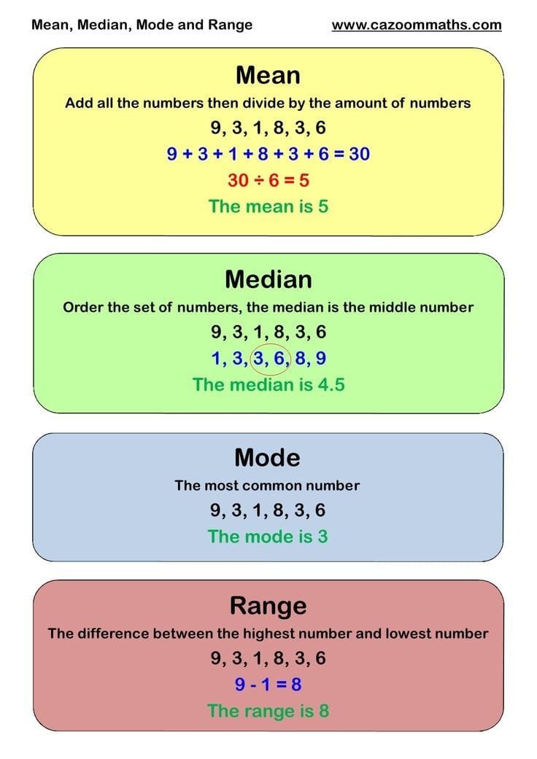

Slide 11
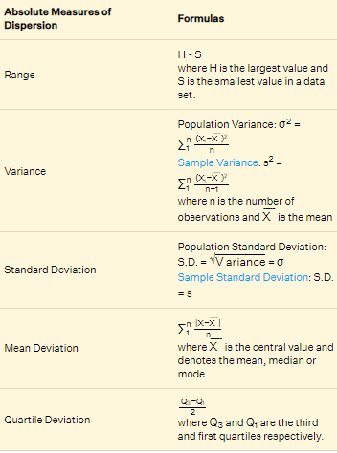
MEASURE OF DISPERSION
Measures of dispersion help to describe the variability in data.
It is a statistical term that can be used to describe the extent to which data is scattered.
Thus, measures of dispersion are certain types of measures that are used to quantify the dispersion of data.

Slide 12
MEASURES OF POSITION
It give us a way to see where a certain data point or value falls in a sample or distribution.
A measure can tell us whether a value is about the average, high or low.
Measures of position are used for quantitative data that falls on some numerical scale.
Box and Whiskers Plot
Interquartile Range (IQR)
Percentiles
Ranks

Slide 13
MEASURES OF FREQUENCY
Measures of frequency are essentially counting. The amount or frequency at which something occurs.
The number of times something happened.
Used with categorical data (ordinal, nominal)
As simple as a tally or count

Slide 14
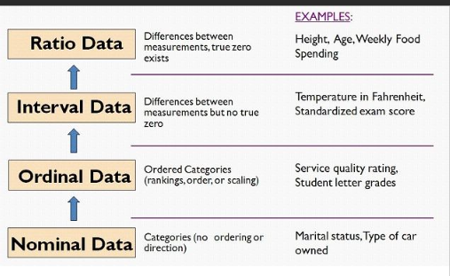
LEVELS OF MEASUREMENT
Level of measurement is a classification that relates the values that are assigned to variables with each other. In other words, level of measurement is used to describe information within the values.

Slide 15
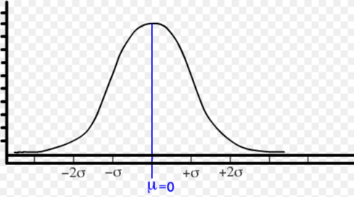
NORMAL PROBABILITY DISTRIBUTION
It is a bell shaped curve, bilaterally symmetrical and having continuous distribution of frequency.
It is determined by 2 parameters Mean and the Variance.
In NPD Mean, Median and Mode coincide at the same point .
MEAN = MEDIAN=MODE.
It is free from skewness.

Slide 16
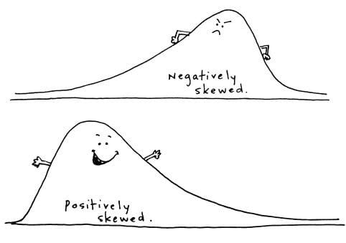
SKEWNESS
Skewness is a measure of asymmetry or distortion of symmetric distribution.
The center of gravity is shifted to one side.
It measures the deviation of the given distribution of a random variable from a symmetric distribution, such as normal distribution.
It can positive and negative as well.
Median>Mean
Mean>Median

Slide 17
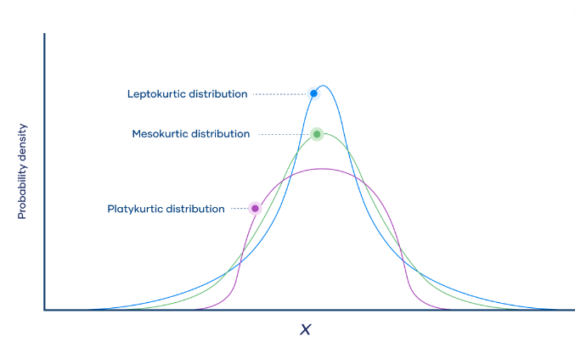
KURTOSIS
Kurtosis is a measure of the tailedness of a distribution. Tailedness is how often outliers occur. Excess kurtosis is the tailedness of a distribution relative to a normal distribution.
Distributions with medium kurtosis
(medium tails) are mesokurtic.
Distributions with low kurtosis (thin tails) are platykurtic.
Distributions with high kurtosis (fat tails) are leptokurtic.

Slide 18
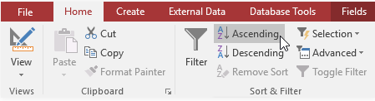
HANDS ON PRACTICE IN EXCEL
The table will now be sorted by the selected field.
1. Sorting And Filtering The Data
Select a field you want to sort by.
Click the Home tab on the Ribbon and locate the Sort & Filter group
Sort the field by selecting the Ascending or Descending command and filter the data according to the requirements. Click the drop-down arrow next to the field you want to filter.
The table will now be sorted by the selected field.

Slide 19
2. Quick Analysis
Step 1: Select all the data across A1:B8 and click on the Quick Analysis tool at the bottom of the selection or hit CTRL + Q to launch quick analysis tool.
Step 2: As soon as you click on Quick Analysis toolbar, you’ll be able to see different options under it named Formatting, Charts, Totals, Tables, Sparklines. Each option has different sub-options that allows you to do different analytical operations. Navigate to Formatting and choose the Icon Set operation under it. This option enables you to set the icons for the data.
Step 3: Once you click on and select the Icon Set option, you’ll be able to see the icon set assigned to your data and it will look like the screenshot given below.
Step 4: Select Data Bars option under Formatting and it will add data bars across the cells which have numeric values for the data.

Slide 20
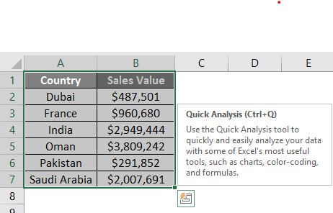
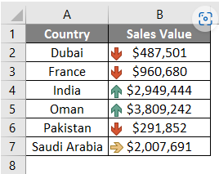
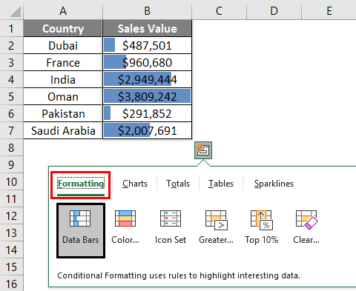
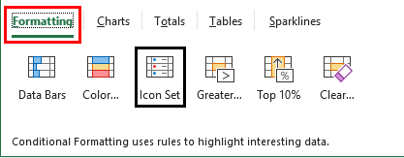
Step 3.
Step 1.
Step 4.
Step 2.

Slide 21
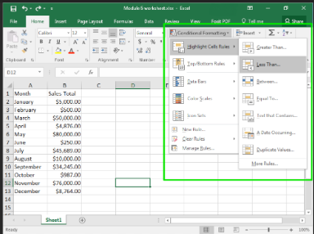
3.Conditional formatting

Slide 22
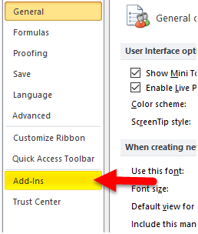
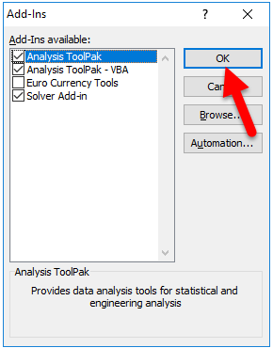
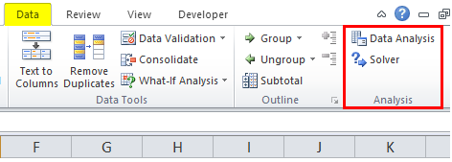
4.Data analysis tab activation
To enable the Data Analysis tool in Excel, go to the File menu’s Options tab. Once we get the Excel Options window from Add-Ins, select any of the analysis pack, let’s say Analysis Tool Pak and click on Go. This will take us to the window from where we can select one or multiple Data analysis tool packs, which can be seen in the Data menu tab.

Slide 23
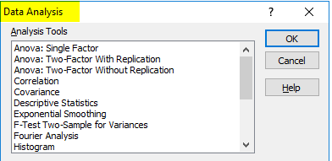
5. Various tools available in data analysis tab

Slide 24
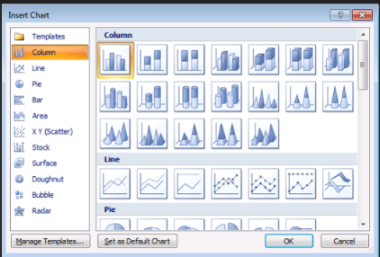
6. Insert chart visualization
On insert menu , click on the chart.
Use the various chart according to the data requirements.

Slide 25
PROBABILITY
Probability means possibility.
It deals with the occurrence of a random event.
The value is expressed from zero to one.
The meaning of probability is basically the extent to which something is likely to happen.
For example,
when we toss a coin, either we get Head OR Tail, only two possible outcomes are possible (H, T). But when two coins are tossed then there will be four possible outcomes, i.e. {(H, H), (H, T), (T, H), (T, T)}.

Slide 26
PROBABILITY DISTRIBUTION
Probability distribution yields the possible outcomes for any random event.
It is also defined based on the underlying sample space as a set of possible outcomes of any random experiment.
These settings could be a set of real numbers or a set of vectors or a set of any entities.
It is a part of probability and statistics.

Slide 27
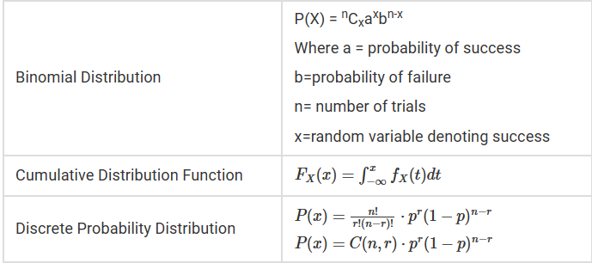
TYPES OF PROBABILITY DISTRIBUTION
There are two types of probability distribution which are used for different purposes and various types of the data generation process.
Normal or Cumulative Probability Distribution
Binomial or Discrete Probability Distribution

Slide 28
INFERENTIAL STATISTICS
Inferential statistics takes data from a sample and makes inferences about the larger population from which the sample was drawn. Because the goal of inferential statistics is to draw conclusions from a sample and generalize them to a population, we need to have confidence that our sample accurately reflects the population
Define the population we are studying.
Draw a representative sample from that population.
Use analyses that incorporate the sampling error.
HYPOTHESIS TESTING ESTIMATION

Slide 29
HYPOTHESIS TESTING
Hypothesis testing refers to analyzing an assumption about a population parameter.
It is used to make an educated guess about an assumption using statistics.
It makes an assumption about how true the assumption is for the entire population from where the sample is being taken.
FOR EXAMPLE,
It is observed that the average recovery time for a knee-surgery patient is 8 weeks. A physician believes that after successful knee surgery if the patient goes for physical therapy twice a week rather than thrice a week, the recovery period will be longer. Conduct hypothesis for this statement.

Slide 30
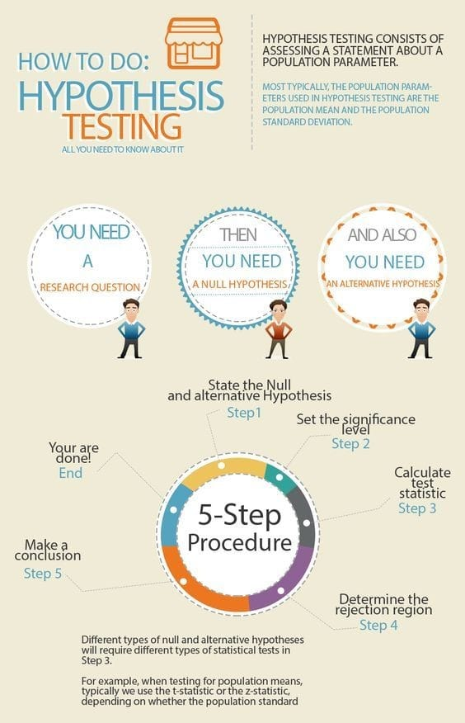

Slide 31
Procedure of Hypothesis Testing
To find the validity of any statement, we have to strictly follow the stepwise procedure of hypothesis testing. After stating the initial hypothesis, we have to re-write them in the form of a null and alternate hypothesis. The alternate hypothesis predicts a relationship between the variables, whereas the null hypothesis predicts no relationship between the variables.
H₀: On average, men are not taller than women.
H_{a}: On average, men are taller than women.

Slide 32
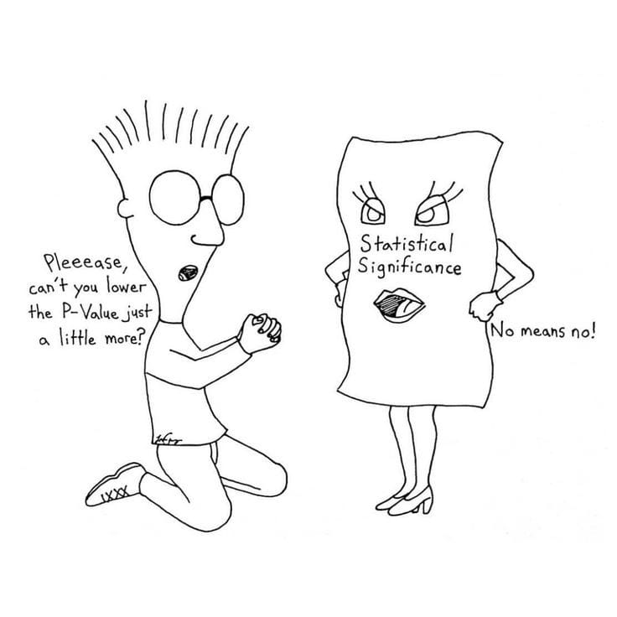
P VALUE
P-value gives us information about the probability of occurrence of results as extreme as observed results .
It cutoff for rejecting the null hypothesis is 0.05. Anything below that, you will reject the null hypothesis.
A low p-value means that the between-group variance is large.
A high p-value suggests there is a high within-group variance and low between-group variance, and any difference in the measure is due to chance only.

Slide 33
CRITICAL VALUE
Confidence intervals form an important part of hypothesis testing.
the alpha level can be determined from a given confidence interval.
Suppose a confidence interval is given as 95%. Subtract the confidence interval from 100%. This gives 100 - 95 = 5% or 0.05.
This is the alpha value of a one-tailed hypothesis testing.
To obtain the alpha value for a two-tailed hypothesis testing, divide this value by 2. This gives 0.05 / 2 = 0.025.

Slide 34
TYPES OF HYPOTHESIS TESTING
T TEST
F TEST
ANOVA
Z TEST
CHI SQUARE

Slide 35
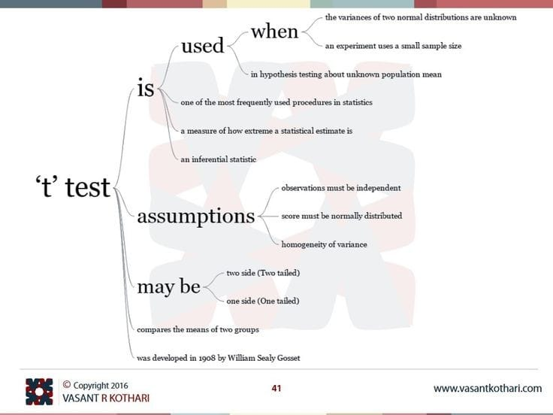

Slide 36
T TEST
If the sample size drops below 30, we use a T-test to find the confidence intervals of the population.
For example,
If one wishes to figure out if the mean of the length of petals of a flower belonging to two different species is the same, a T-test can be done. The user can select petals randomly from two other species of that flower and come to a standard conclusion.

Slide 37
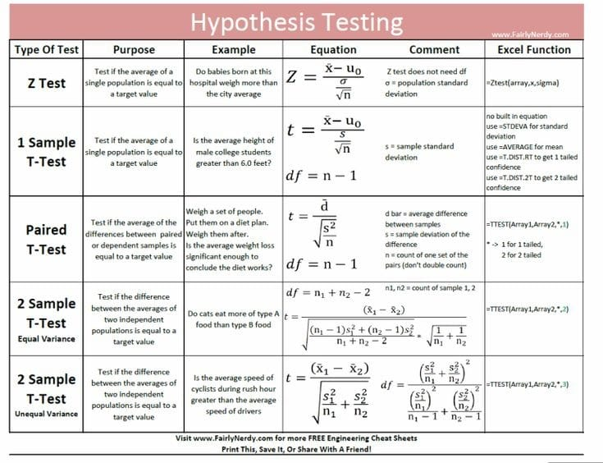

Slide 38
Z TEST
The z test in hypothesis testing is used to find the z test statistic for normally distributed data. The z test is used when the standard deviation of the population is known and the sample size is greater than or equal to 30.

Slide 39
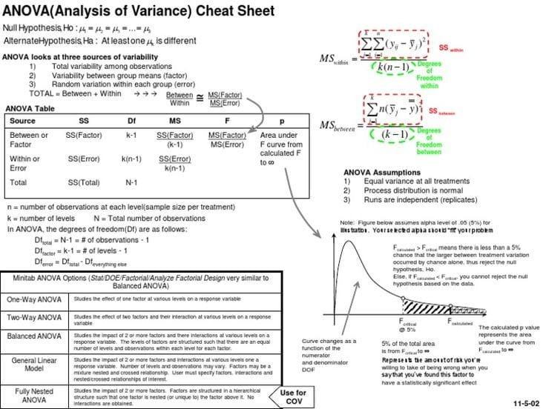
ANOVA TEST

Slide 40
CHI SQUARE
A chi-squared test ( χ²) is a data analysis on the basis of observations of a random set of variables.
It is a comparison of two statistical data sets.
This test was introduced by Karl Pearson in 1900 for categorical data analysis and distribution. So it was mentioned as Pearson’s chi-squared test.
The chi-square test is used to estimate how likely the observations that are made would be, by considering the assumption of the null hypothesis as true.

Slide 41
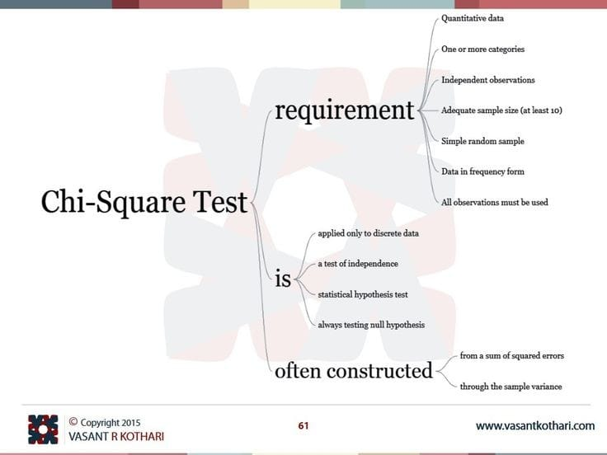

Slide 42
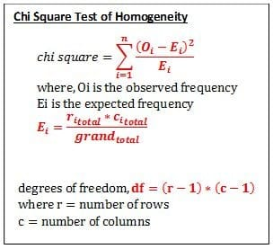

Slide 43
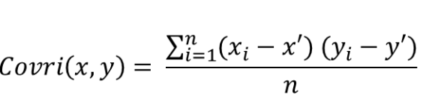
COVARIANCE
Covariance and Correlation are two mathematical concepts which are commonly used in the field of probability and statistics.
Covariance –
It is the relationship between a pair of random variables
It can take any value between -infinity to +infinity
Formula – For Population:

Slide 44
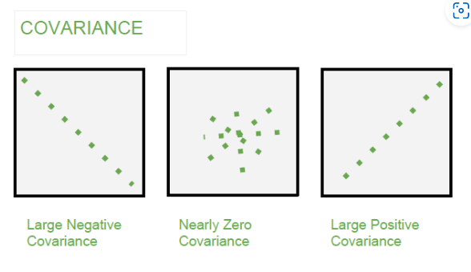
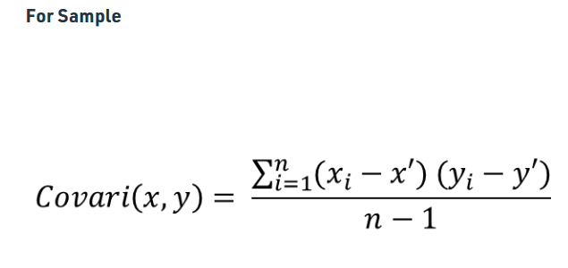
For Sample
Here, x’ and y’ = mean of given sample set n = total no of sample xi and yi = individual sample of set

Slide 45
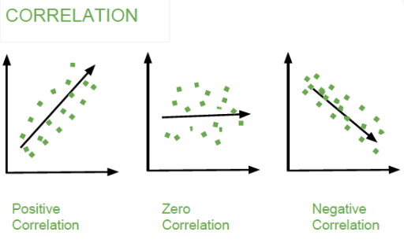
CORRELATION
It show whether and how strongly pairs of variables are related to each other.
Correlation takes values between -1 to +1.
In this variable are indirectly related to each other.
It gives the direction and strength of relationship between variables.

Slide 46
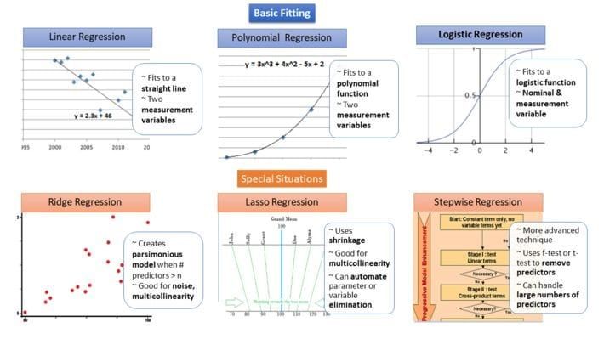
REGRESSION
Regression analysis is a set of statistical methods used for the estimation of relationships between a dependent variable and one or more independent variables.
It can be utilized to assess the strength of the relationship between variables and for modeling the future relationship between them.

Slide 47
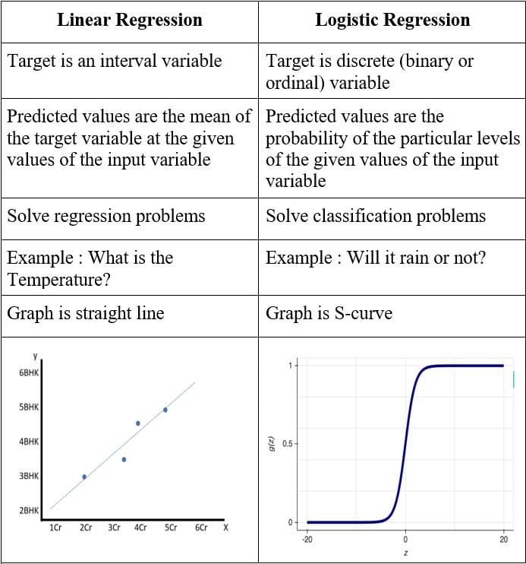

Slide 48
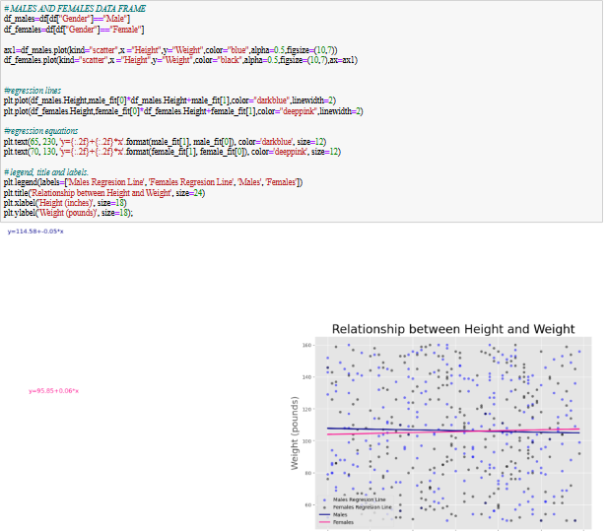
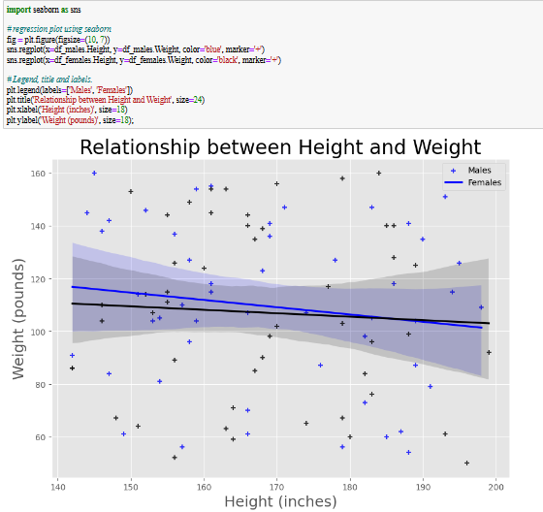
Practical implementation of regression in python

Slide 49
PROJECT
Importing of seaborn library into Data to apply multiple types of graphs for better understanding .
Red wine quality data
Titanic
Flights
Tips
Penguins
Iris

Slide 50
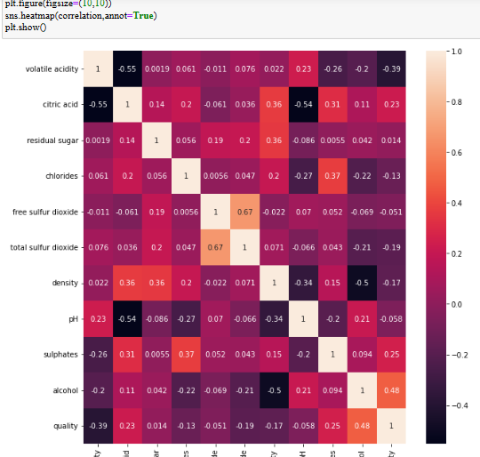
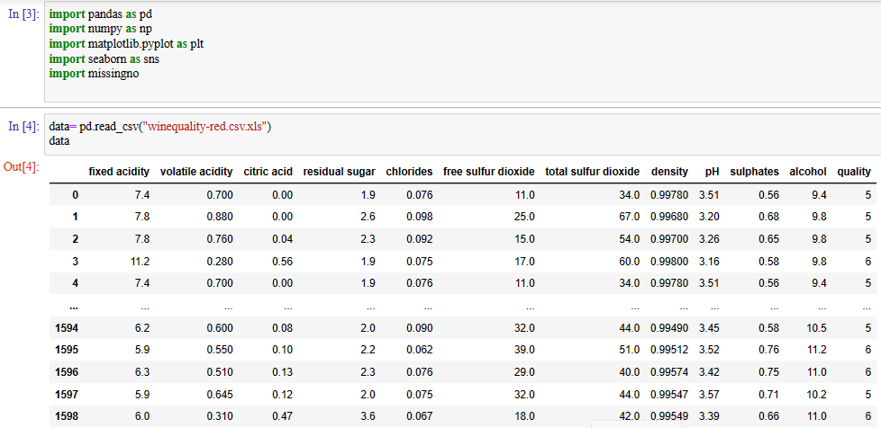
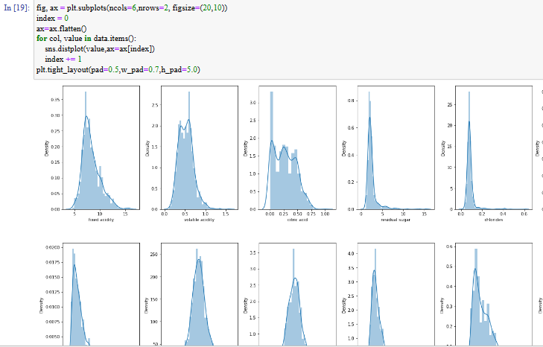
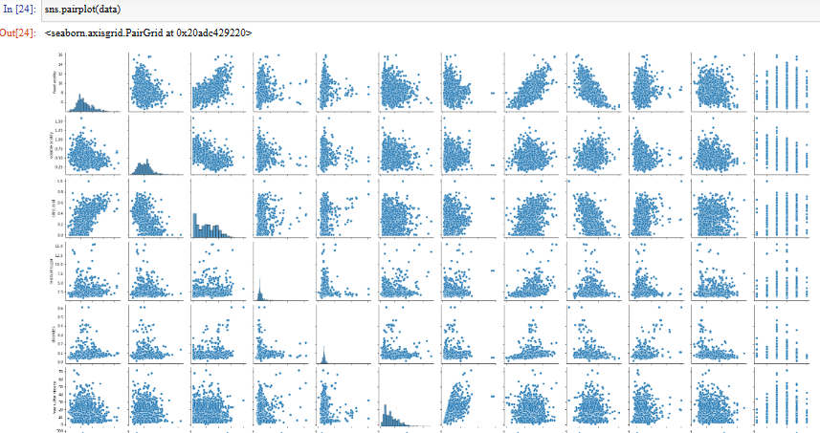
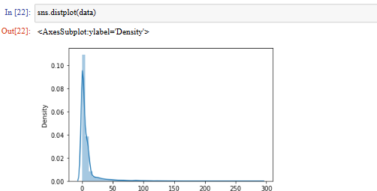
1.RED WINE QUALITY

Slide 51
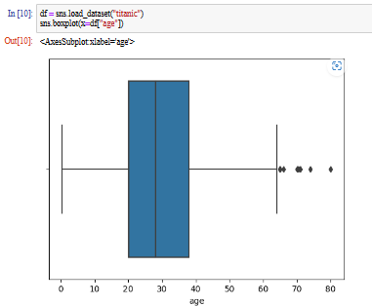
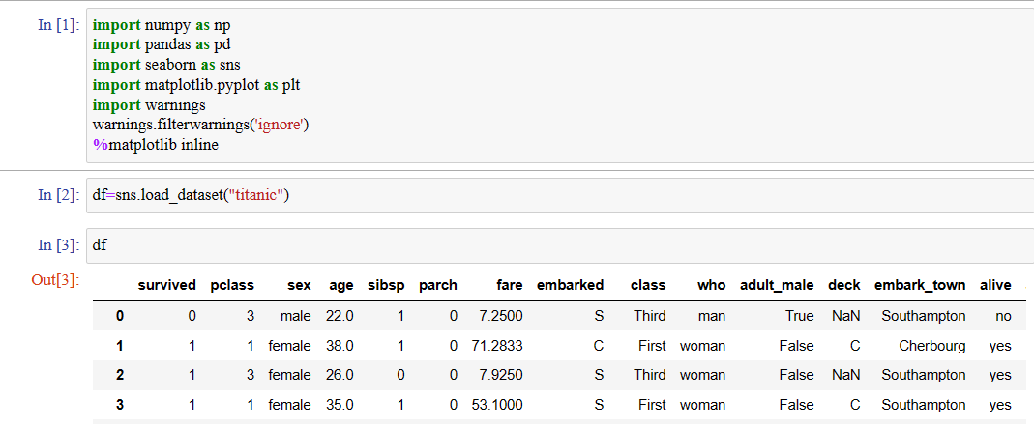
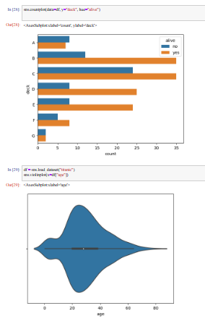
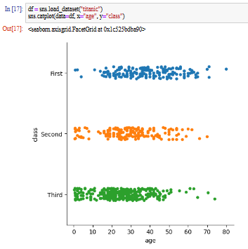
2.TITANIC

Slide 52
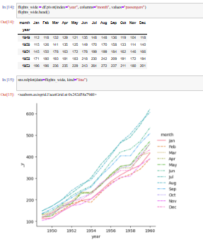
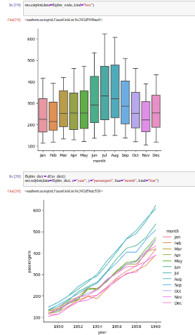
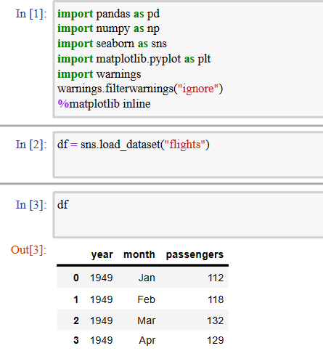
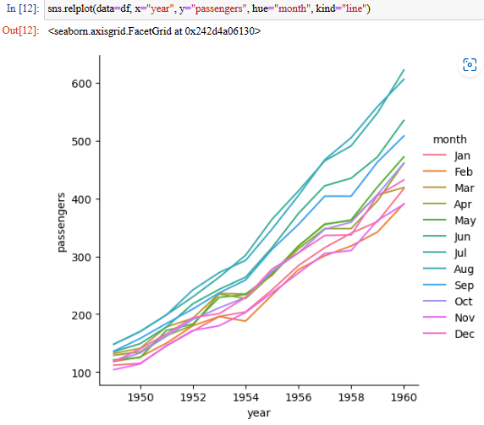
3. FLIGHTS

Slide 53
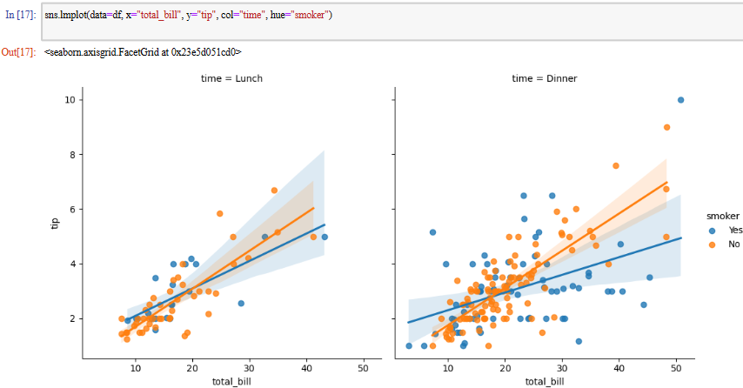




4.TIPS

Slide 54






5. PENGUINS

Slide 55





6. IRIS

Slide 56

EXCEL PERFORMANCE DASHBOARD

Slide 57


